Slide 1

Chairperson of Board of Management
Secondary school
February 2023

Slide 2
Reflection
ChairpersonsReflectionSpring2023.m4v (sharepoint.com)

Slide 3

Prayer for Chairpersons
Dear God, As we gather this evening, Grant us wisdom, courage and discernment.
So that our work, in your name, may bring joy to our school communities.
Amen

Slide 4


Slide 5
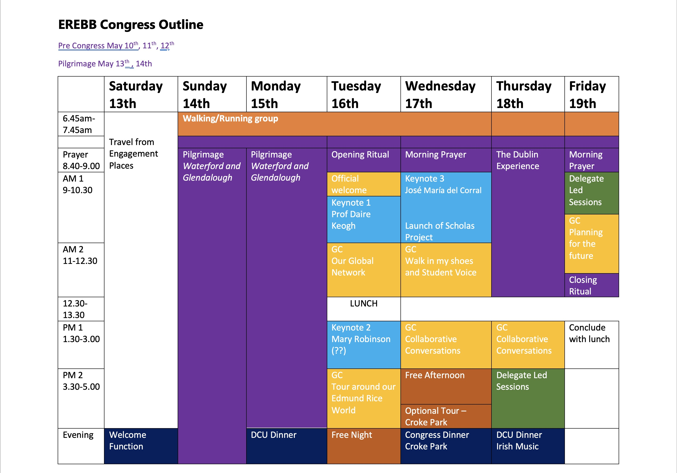

Slide 6

Looking At Our School (LAOS) 2022
Used by Boards of Management
School Self Evaluation and School Improvement Plan
Formulating Roles and Responsibilities for middle leadership positions
Appointment process for principal, deputy principal and assistant principal (AP1 and AP II)
Strategic Planning
Preparing for inspections

Slide 7
What has changed?
The framework has been updated to reflect recent educational reform, thinking and developments in areas such as
1. Child safeguarding
2. Anti-bullying
3. Inclusion, student participation and parent participation
4. Education for sustainable development (ESD)
5. Support of student transitions, and Cosán, the national framework for teachers’ learning.
There are also strengthened references to aspects of learning and teaching that became all the more significant as schools responded to the needs of their students in the context of COVID-19. These aspects include digital competence, approaches to remote learning and teaching, the role of assessment and feedback in supporting progression in learning, and the development of students’ independent learning skills.

Slide 8
Changes from LAOS 2016 – emphasis on Sustainability
SUSTAINABILITY
In Learning & Teaching (Domain 1: Learner Outcomes), we see text which recognises students as “key contributors to our sustainable future”. Effective practice will be demonstrated through “environmental, social and economic issues and of active citizenship” enabling them to “act responsibly for a more sustainable world”. In Leadership & Management (Domain 2: Managing the Organisation) schools are encouraged to demonstrate how they value and promote “a commitment to sustainable development” and implement “practices and policies that embed the principles of sustainability in the daily routines of the school”.

Slide 9
WSE Questions - Training
How do you see your role on this board? What do you bring to it?
What training have you received – new members and more experienced?
How have you been supported in your work and by whom?
What Child Protection training have you received as board members?
What training has the Deputy DLP received? How has the board ensured the Deputy DLP is kept in the loop regarding role and responsibilities?
Tell us about the staff training in relation to Child Protection and how do new staff get training when they arrive at the start of the year and during the year?
I see that the BOM Agreed Reports are published on the website. What measures are in place to ensure enough information is shared and not too much is shared?
I notice you have ‘zero reports’ down for the CPOR in the last five Agreed Reports. Is this necessary – should you just state that the CPOR was presented as you may feel you’ll have to provide a different number when there is an issue and this may disclose more information than is necessary?

Slide 10
WSE Questions – Whole School Guidance Plan
Tell us about your role in reviewing the Whole School Guidance Plan. In one set of minutes, it is recorded that the board was satisfied with its progress – what criteria did you use to make this judgement? What are the next steps needed for its development?
How was the Whole School Guidance Plan brought into being? Who was involved from the beginning and tell us about the role of the board, to date?

Slide 11
WSE Questions - Planning
I notice you have a Strategic Plan for your three year term. Tell me about the main areas you have identified for development and why these areas have been selected.
What evidence have you that the current curriculum on offer to students meets their needs?
How does the board feel about the uptake of subjects at Higher Level in Leaving Certificate? Is this an area that has been considered for development and, if so, how will it be managed by the board?
How does the board promote and support teacher cpd? How does the board plan for leadership development in the school?
How is Student Voice reflected in your strategic planning?

Slide 12
WSE Questions - Other
Do AP1 and AP2 teachers get an opportunity to meet the board? Given the delegated roles and responsibilities that AP holders have, do you think you should offer them an opportunity to meet the board?
You mentioned in your presentation that you strive for excellence in learning and teaching, one of your key Charter elements. What does ‘excellence’ mean to you? How do you rate your progress? What are the areas you have identified for attention?

Slide 13

Internal Communications: Rationale…Is the message getting out there?
Internal and External Communications
Relevance of the Trust to its stakeholders
Improve the methods of communicating with stakeholders
Opportunity to highlight the work of the Trust to stakeholders on a regular basis
Encourage greater use of the ERST website for stakeholders with resources
Feb. 2023

Slide 14
Interconnect
Student Council Publications
Meetings, Newsletter, eSíol
Student
Councils
E-Síol and Newletters
BOM
Parents Associations
Highlight the relevance of programmes to our schools
Direct Communication
Direct Communication
Promotion of ERST Calendar
Direct Communication
Update Resources for Website
Internal
Communications and
Networking
2023
Direct Communication
Contact with DP, GC,RE, Link persons from ERST
Meetings and IT
Resources/Seminars for schools/teachers
Events
Principals
Edmund Rice Feast Day
RE teachers
Guidance Counsellors
AEN
Network Meetings
Conference
Start of Academic Year

Slide 15
Structure Set up for Increased Communications
Inform
Obtain
Obtain correct email address for all the listed stakeholders (setting up a generic Student Council email address e.g. studentcouncil@yourschool.ie
Pilot
Examine participation rates before and after the process
Improve and develop the structure/set up over time
Principals Deputy Principals
Link Persons BOM
Parents Association RE teachers
Guidance Counsellors AEN teachers
Student Councils Subject Teachers*

Slide 16
Edmund Rice Prayer
O God, we thank you for the life of Blessed Edmund Rice.
He opened his heart to Christ present in those oppressed by poverty and injustice.
May we follow his example of faith and generosity.
Grant us the courage and compassion of Blessed Edmund as we seek to live lives of love and service.
We ask this through Christ our Lord. Amen

