Slide 1
Understanding the Water Crisis in Gaza
An in-depth exploration of the causes, impacts and solutions

Slide 2
Welcome & Objectives
Overview of the water crisis in Gaza
Key learning objectives
Outline of today’s class

Slide 3
Icebreaker
Discussion starter:
‘What do you think are the main factors contributing to water scarcity in conflict zones?’

Slide 4
Historical & Political Context
After World War I, Gaza was part of the British Mandate for Palestine.
There was a Jewish minority and an Arab majority as well as other small ethnic groups.
Tensions between the Arab and Jewish communities grew.
During the 1948 Arab-Israeli War, Gaza was occupied by Egypt and became a focal point of the Israeli-Palestinian conflict.
During the Six-Day War in 1967, Gaza was captured by Israel and remained under Israeli military occupation until 2005

Slide 5
Historical & Political Context
In 1994, the Oslo Accords established the Palestinian Authority and granted it limited self-governance in Gaza.
In 2007, Hamas took control of Gaza following a conflict with the Fatah party. Since then, the region has faced frequent conflicts with Israel and significant humanitarian challenges.
The situation in Gaza remains highly complex and dynamic, influenced by a mix of historical, political, and social factors.

Slide 6
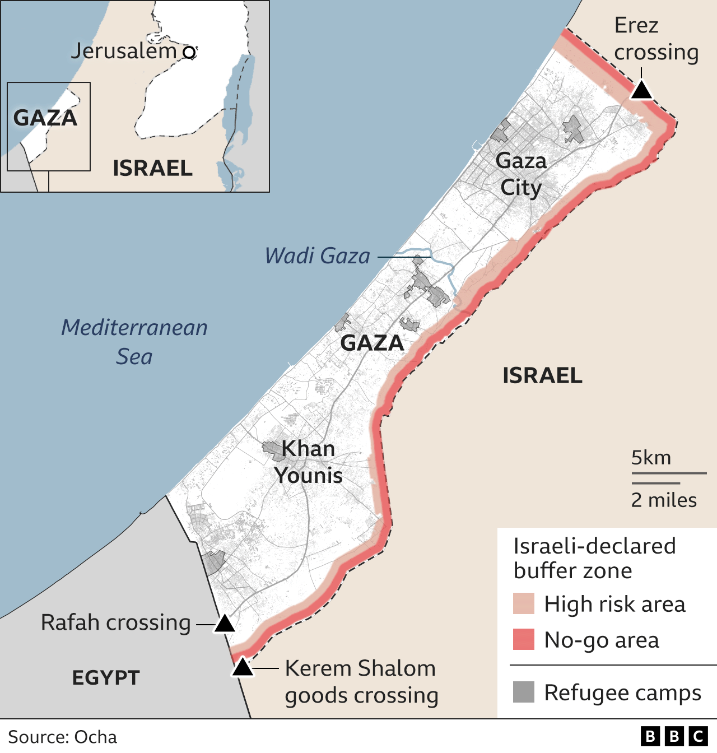
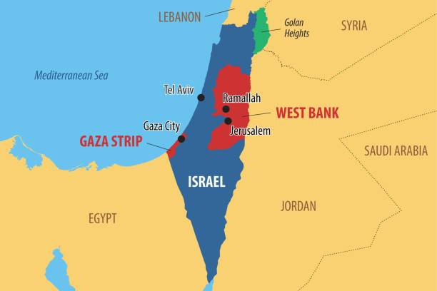

Slide 7
Key Political Factors
- Difficulties with Transport, aids & access
- In the West Bank, OCHA documented 645 checkpoints, roadblocks
- Checkpoint 54 in Hebron, fortified with facial recognition
- Impact on Infrastructure Development
- As of January, direct damage to Gaza's infrastructure amounted to
and barriers.
technology, automated the exclusion of Palestinians.
$18.5 billion.

Slide 8
Key Political Factors
- International Aid Dynamics
-U.N. agencies spent nearly $4.5 billion in Gaza.
- 400 children denied access to critical treatment in the first half of
- 1,000 children had limbs amputated in inadequate conditions.
- By mid-December, 93% of people were not being met with the
2024
adequate daily intake food.

Slide 9
Live Interactive Map of the Conflict & Stats
Interactive Map of Gaza
38,066 killed
71,220 injured
130 journalists killed
2 million displaced
99,600 completely destroyed homes
406 damaged schools
326 healthcare professionals killed and 430 injured

Slide 10
Current Water Crisis in Gaza Today
Overview of the Situation;
Hundreds of Gaza's water and sanitation facilities have been damaged or destroyed since Israel began military action against Hamas, satellite analysis by BBC Verify has found.

Slide 11
Current Water Crisis in Gaza Today
- Statistics on Water Scarcity
- Access to water from all sources dropped by 95% after October 9th
- The UN estimates that the average Gazan is living on 3L of water a day of all needs. The UN emergency standard is 15L
- All five of Gaza’s wastewater treatment plants and most of its 65 sewage pumping stations were forced to shut down by mid-November
- 70% of Gazans resort to drinking salty and contaminated water straight from wells.

Slide 12
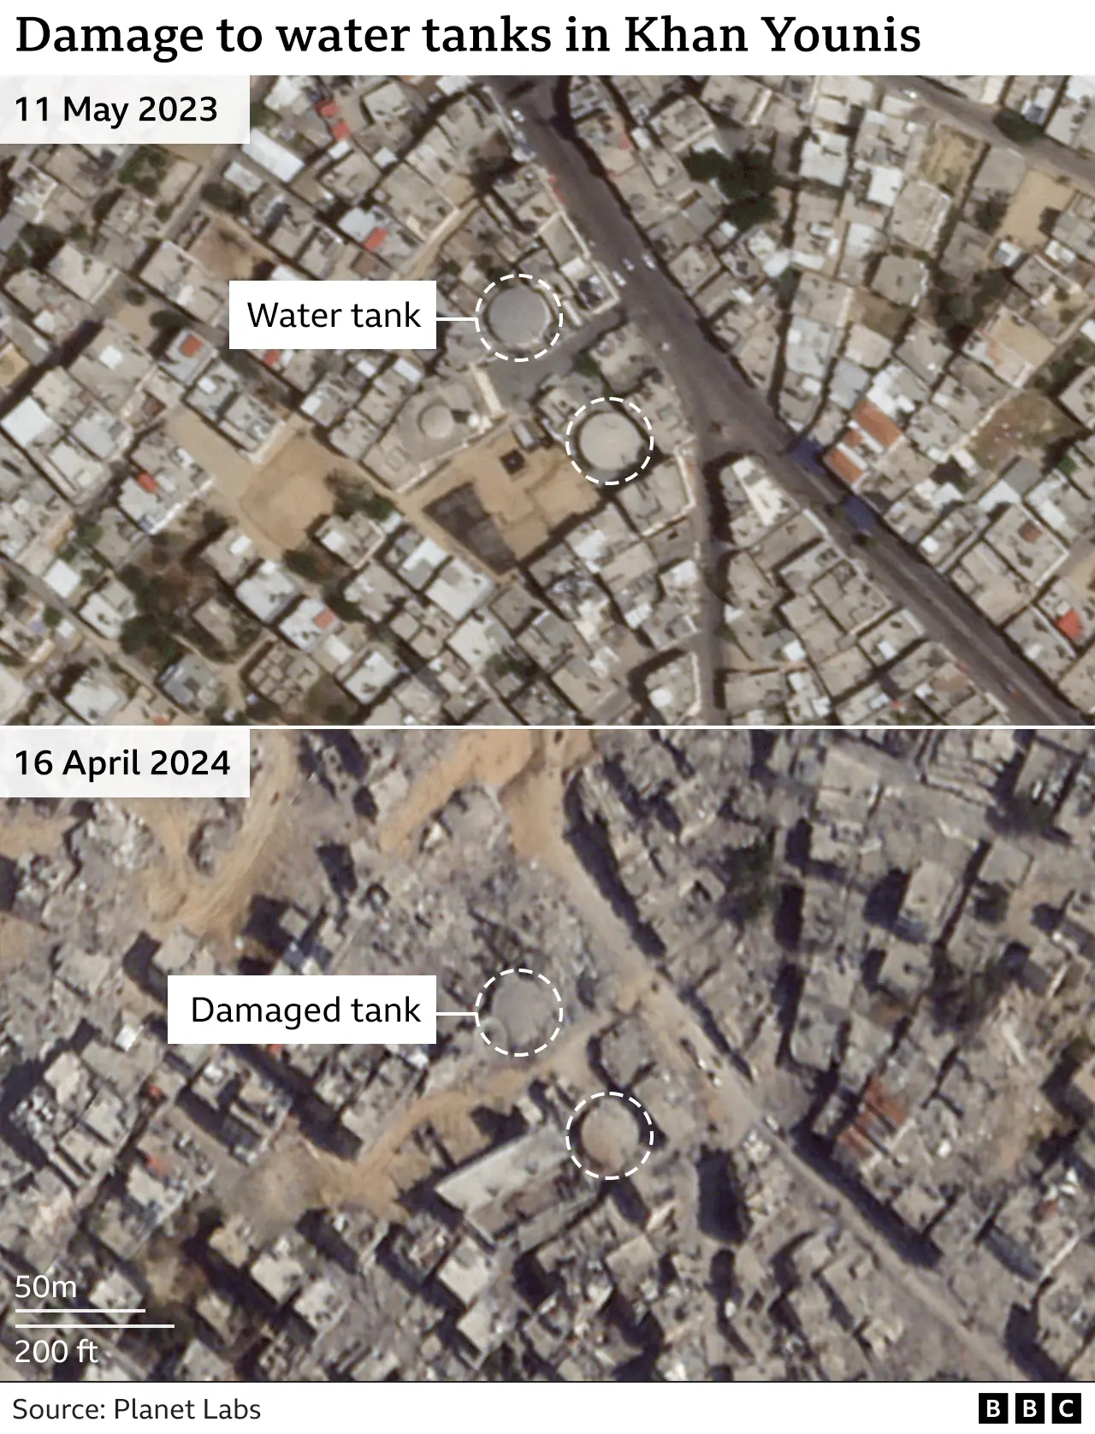
- Effects on Daily Life
Human Dignity (washing, cleaning, going to the bathroom), nutrition, Increased risk of disease + infection. In Gaza's population of some 2.3 million, more than 1 million cases of acute respiratory infections have been recorded since the war began, along with more than half a million of acute diarrhoea and more than 100,000 cases of jaundice, according to the United Nations Development Program

Slide 13
A glimpse into Gaza’s water crisis
https://www.youtube.com/watch?v=bCh043-gLIM

Slide 14
Post Documentary Discussion
What were the most striking aspects of the crisis?
How does the crisis impact daily life in Gaza?

Slide 15
Contributing Factors to the Crisis
- Pollution
- Over-Extraction
- Lack of Infrastructure
- Political Restrictions

Slide 16
Interactive Group Activity
Divide into groups
01
02
Analyse one contributing factor
03
Prepare a brief presentation

Slide 17
Group Presentations

Slide 18
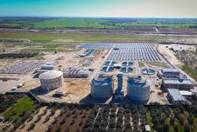
Solutions and Proposed Actions
Desalination and Water Treatment
International Aid and Local Initiatives
Policy Changes

Slide 19
Feasibility of Solutions
What challenges do these solutions face?
How can they be implemented effectively?

Slide 20
Summary and Reflection

Slide 21
#ESRTwaterforlife
https://youtu.be/JM3I3m4Woc0?si=CyPJ2AXG0jw4jR5j

Slide 22
Any questions or thoughts?

Slide 23
Thank You for Listening

