Slide 1

Edmund Rice Prayer
O God, we thank you for the life of Blessed Edmund Rice.
He opened his heart to Christ present in those oppressed by poverty and injustice.
May we follow his example of faith and generosity.
Grant us the courage and compassion of Blessed Edmund as we seek to live lives of love and service.
We ask this through Christ our Lord. Amen

Slide 2

Primary Board of Management Training
Primary Boards of Management Induction Training
Edmund Rice Schools Trust
January 2024

Slide 3
Agenda
Boards of Management in ERST Primary School
Ethos
- Charter in action
The Board in Action
- How a Board is run, roles, supports
- ERST Trusteeship
- Fundamental Principles
Finance & Property

Slide 4
Introductions
The chair or member introduces himself/herself and the school
  Name of school and location
  Size and type of school
  Experience to date

Slide 5
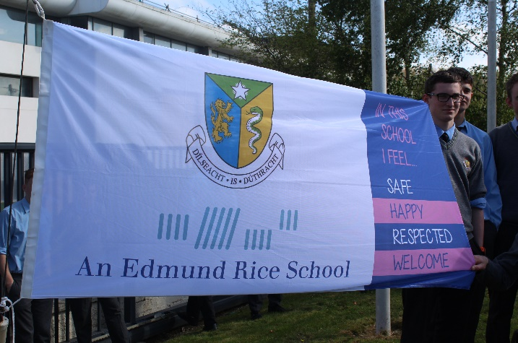
The Edmund Rice School

Slide 6
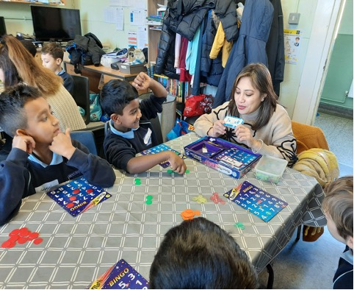
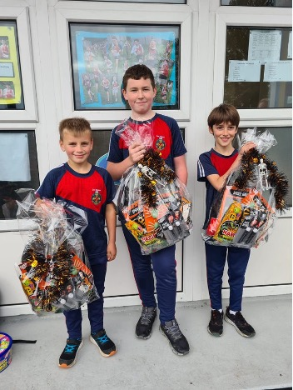
In Ireland
33 Primary Schools
All-boys, many coeducational schools - increasing annually, some Gaelscoileanna, one with an Irish stream – sruth Gaeilge
63 Secondary Schools

Slide 7
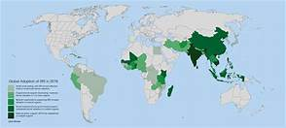
The Edmund Rice Global Network
Ireland 96 Zambia 12
N Ireland 9 W Africa 4
England 12 E Africa 5
N America 18 S Africa 9
S America 5
Australia 78
New Zealand 5
India 22

Slide 8
Who was Edmund?
A wealthy businessman
Following a personal tragedy he changed direction of his life
Opened a school for poor boys in Mount Sion, Waterford in 1802
Founded an order of Religious Brothers
Edmund died 1844.
Schools opened in Carrick on Suir, Dungarvan, Cork, Dublin, Limerick
Edmund’s Brothers opened schools all around Ireland and the World.
In 1996, Edmund Rice was beatified by Pope John Paul 11 becoming Blessed Edmund.
What date was your school founded?

Slide 9
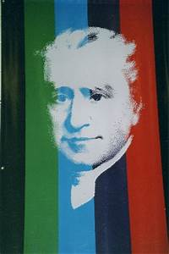
What did Edmund stand for…?
The right to dignity
Care for those who are disadvantaged
Opposition to poverty
Importance of Education
Commitment to Jesus Christ

Slide 10
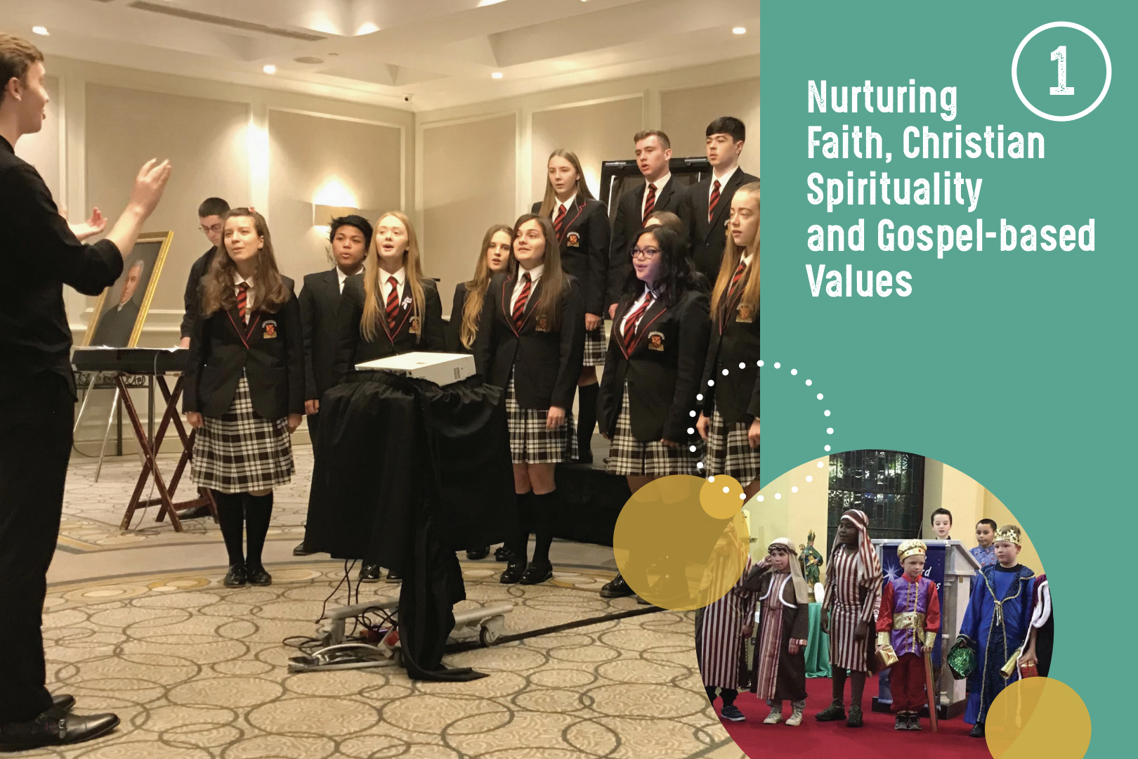
An Edmund Rice School

Slide 11
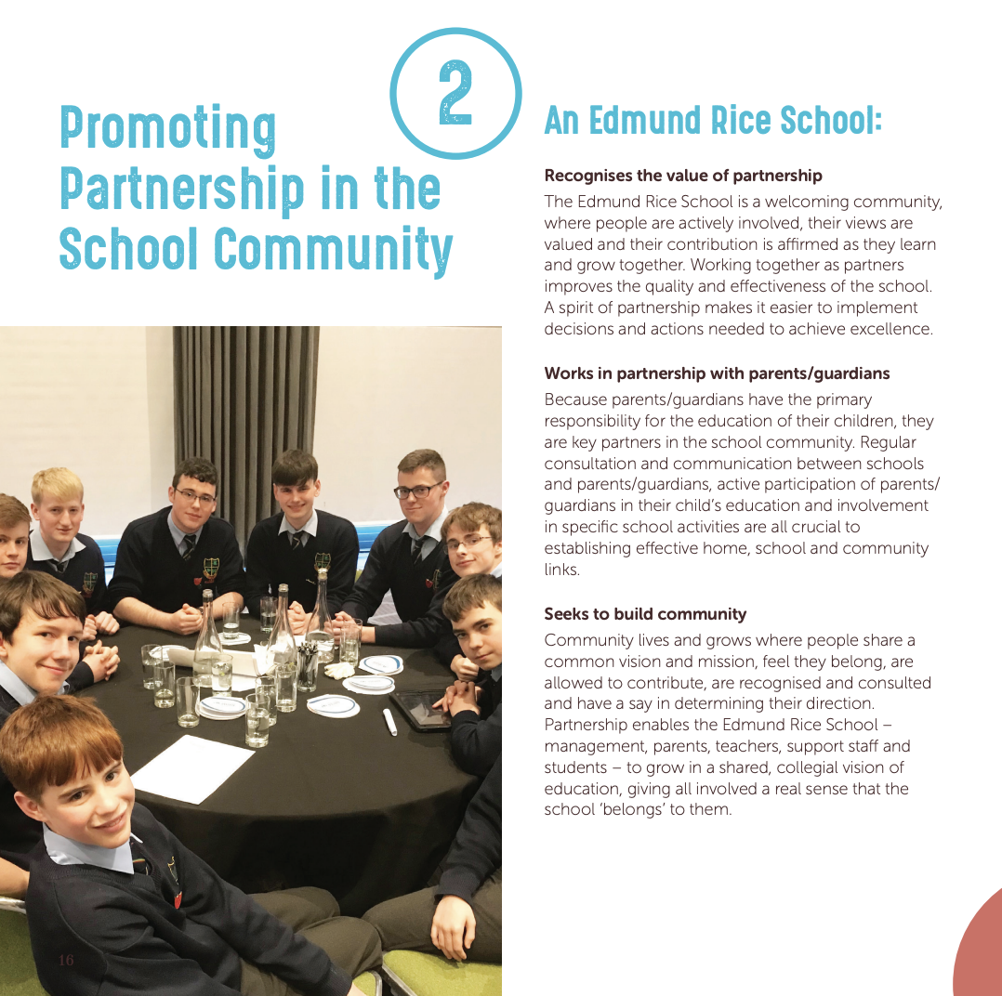

Slide 12
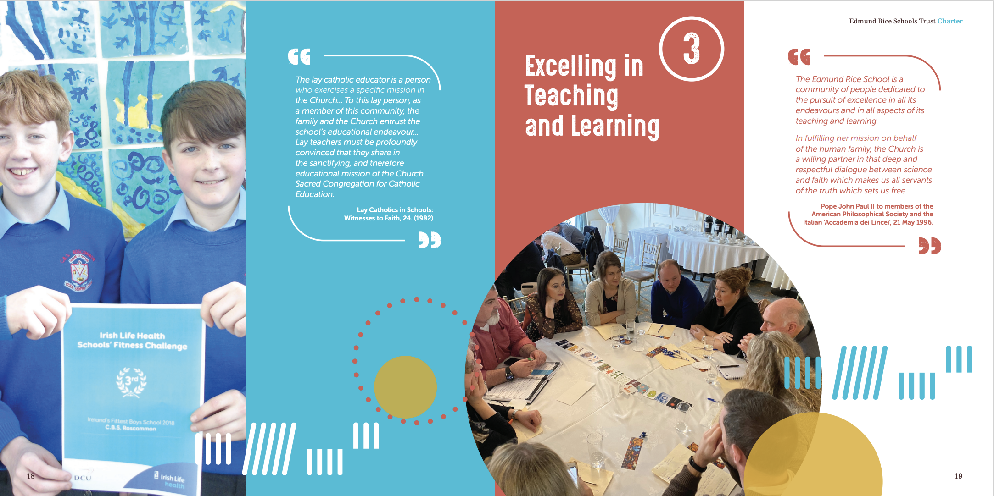
An Edmund Rice School

Slide 13
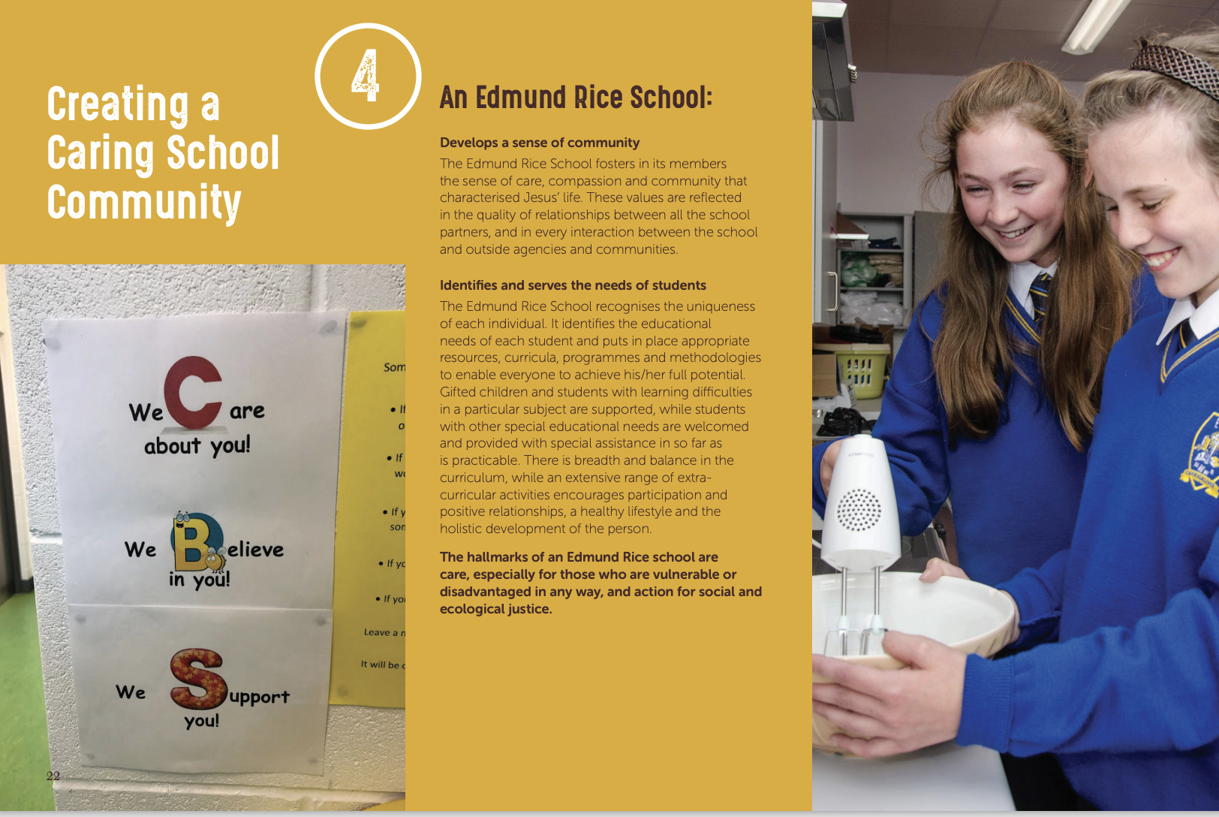

Slide 14

An Edmund Rice School

Slide 15


Slide 16
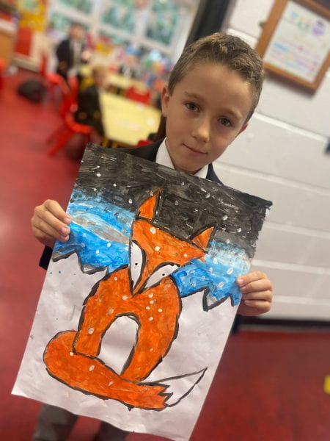
Today, Edmund Rice Schools across Ireland continue to educate young people in the spirit and vision of Blessed Edmund.
How does this happen in your school?

Slide 17


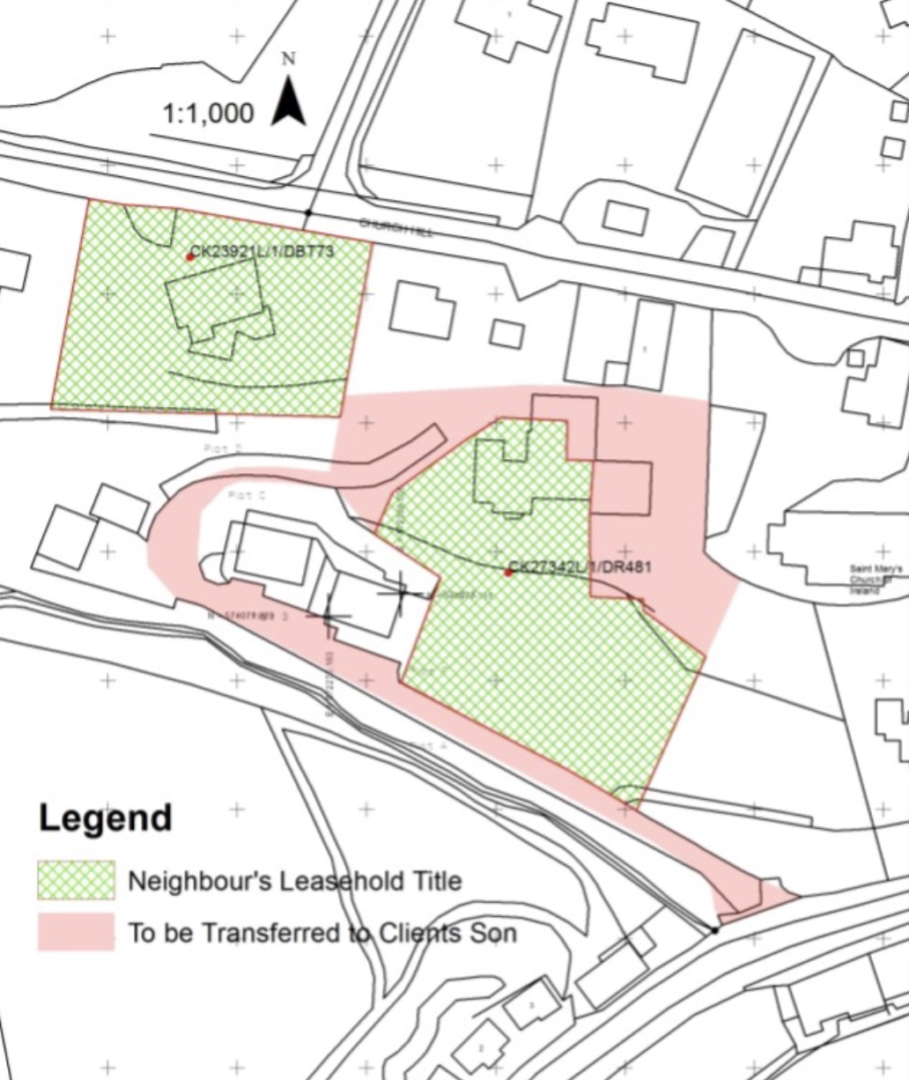
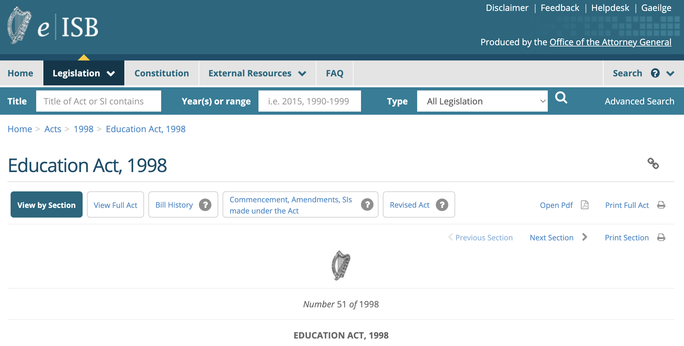
Governance Documents
Governance Manual
Education Acts and Circulars
Schedules 1 and 2

Slide 18
The Composition of the Board
2 Members of Boards nominated by the ERST
– The Chairperson and Trustee/Patron Nominee
2 are nominated by the Parents
1 teacher is nominated by the teachers
The Principal is a member of the Board
These 6 members nominate the 2 Community Representatives
All 8 members are appointed by the Patron

Slide 19
Trusteeship & Patronage
The Trustees (ERST) hold key areas of responsibility
-Ethos
-Property
-Financial
The Patron appoints the Board of Management.
Notes:
Schedule 1 = Map of area for which Board has responsibility
Schedule 2 = Catholic Schedule and the Charter.

Slide 20

Fundamental Principles
Corporate Nature
Conflict of Interest
No Criticism
Confidentiality
Child Protection

Slide 21
Corporate Nature of the Board
Once appointed, members act as ‘one body’
All members must take responsibilities for decisions taken
Members bring their own views but are not there on behalf of a particular constituency.

Slide 22
Confidentiality, Conflict of Interest, No Criticism
All matters are confidential unless otherwise agreed by the Board
GDPR
NB Agreed Report
No Criticism – Individual’s entitlement to Natural Justice
Conflict of Interest – if in any doubt, declare
Follow Agreed Procedures – Grievance, Complaint and appeals

Slide 23

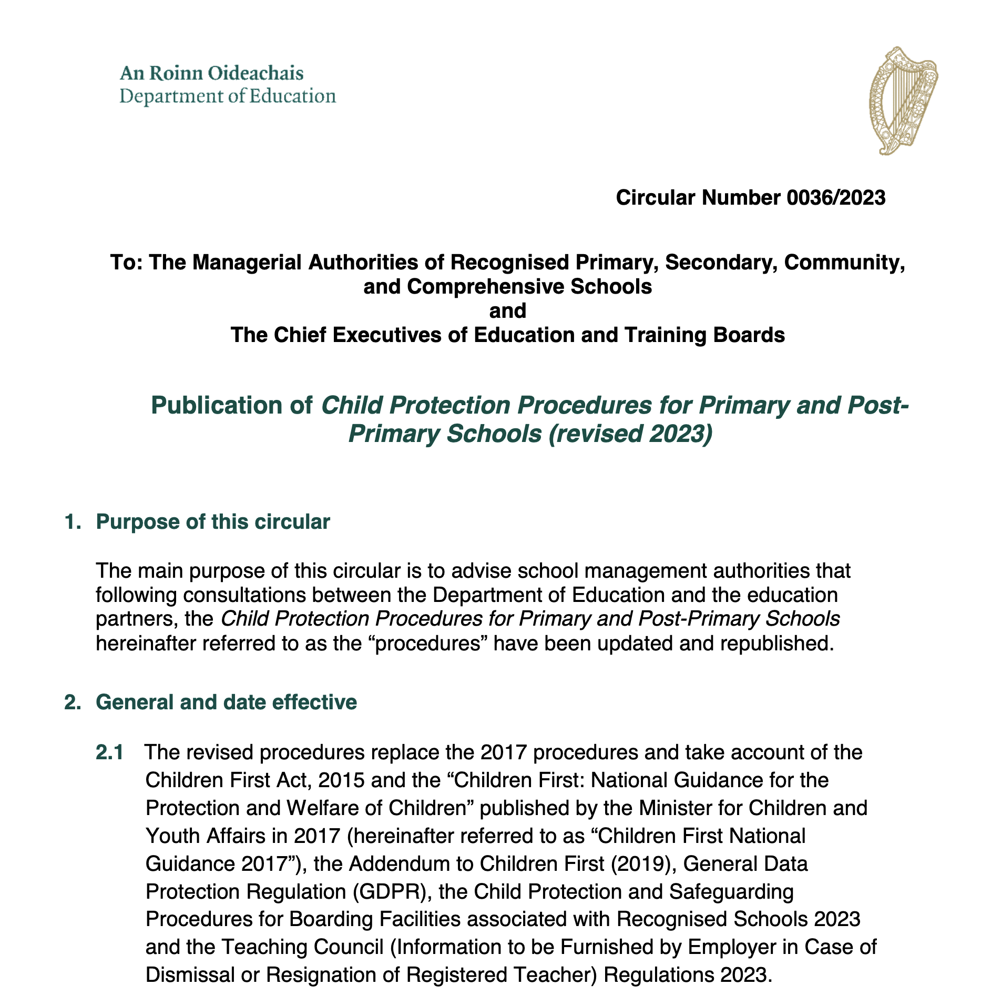
Child protection
Ensure compliance with Children First Act (2015)

Slide 24
Child Protection
The Child Protection Procedures for Primary and Post Primary Schools 2023 (the procedures) which issued under Circular 0036/2023 apply to all recognised schools.
Best practice set out, including
Reporting procedures to be followed by teachers
Guidance & direction for BOM – templates etc
Oversight requirements (CPOR to board)
Vetting requirements
An inspection process is in place to monitor Child Protection

Slide 25
Child protection Main changes 2023
Updated reporting procedures enabling the BOM to undertake oversight requirements without disclosing names, However, the protocol authorising immediate action unchanged – no need to anonymise
Template for annual review of Safeguarding Statement has been updated and this new version must be used
Teaching Council must be informed if a teacher against whom allegations have been made leaves the school

Slide 26
Accountability
To the Patron/Trustees/DE
Ethos, Curriculum, Buildings and Finance – (Sect 15.2 C)
To the School Community
Students, Parents, Teachers and Parish. (Annual Report)
To the Dept of Education (FSSU guidelines)
Curriculum, Resources and Finance.

Slide 27

Legal Framework
Department Circulars/Guidelines
Education Act 1998
Education Welfare Act 2000
Equal Status Act 2000
Employment Equality Act 1998.
Health and Safety Act 1989
EPSEN Act 2004
Children First Act 2015

Slide 28
Statutory Duties of the Board
Education Act 1998
Section 15 Education Act 1998
Manage school on behalf of the Patron
Uphold characteristic spirit of school
Publish Admission Policy and Behaviour Policy including suspension/expulsion policy
Provide for students with special needs and disabilities
Section 18 Education Act 1998
Keep accounts and ensure accounts audited or certified annually
Section 20 Education Act 1998
Provide information for parents
Notes:
28

Slide 29
Advice & Support
Edmund Rice Schools Trust www.erst.ie
Department of Education (www.education.ie)
CPSMA (www.cpsma.ie)
Diocesan Offices
IPPN (www.ippn.ie)
INTO (www.into.ie)
General – NPC, HSE and Citizens Advice Bureau
Handbooks –CPSMA Handbook, Governance Manual for Primary Schools 2023-2027. Rules for National Schools
NB. ERST provides ongoing advice and support

Slide 30
Role of the Chairperson
  Convenes meetings
  Agrees Agenda with Principal
  Preparation for meetings
  Is the correspondent Board with DES
  Co-Signs forms, cheques etc
  Liaises with principal between meetings

Slide 31

Role of the Principal
  The Principal is Secretary to the Board
  Minutes - recording decisions, voting, attendance, outcomes of POR interviews & employment contracts
  Brings all relevant correspondence to the Board
  Keeps minutes safely
  Makes minutes available to Patron /ERST/DE (Section 15 2 c of the Ed Act)
  Circulates the notice of the meetings
  Conveys the Agreed Report to the Staff, Parents

Slide 32
Principal’s Report
Teaching & Learning (LAOS 2022)
Enrolments
Staffing
Holidays/closures
Repairs/Maintenance/H&S
Future Planning
Policies
Legislation/guidelines
Training/professional development
Resources

Slide 33

Finance
  FSSU Guidelines & Supports www.fssu.ie
  Proper Books of Account & School Bank Account
  Day to day expenditure; expenditure must not exceed income;
  Annual budget
  Sub-Committee on Finance or Treasurer
  Cheque signatories – no blank cheques!
  Use of school premises – See ERST Guidelines on www.erst.ie
  School Insurance
Notes:
33

Slide 34
The Treasurer/Finance Subcommittee
The Treasurer/Finance Subcommittee
- FSSU support & guidelines
Has procedure to keep records
Files receipts
Maintains accounts
NB - Financial report to each meeting
Annual budget
End of year summary and audit/certification

Slide 35
Subcommittees of the Board
Policy Review & Development
School Plan (WSE MLL)
Interview Panel for Posts
Finance Subcommittee
Other subcommittees as needed– terms of reference must be outlined by the BoM in advance.
Remember contact ERST if legal advice is required
NB Inform Insurance Company First!

Slide 36

Running a meeting
Checklist
Agenda – consultation, circulated in advance
Duration of meeting – max 1.5 hours
Venue
Learning in action at each meeting
Reports – Child Protection, Bullying
Ethos underpins decisions
Health Warning - A.O.B. & late items!

Slide 37

Feedback
1. Are there other issues that you would like to see included in a future training session? Answers in the chat.

