Slide 2
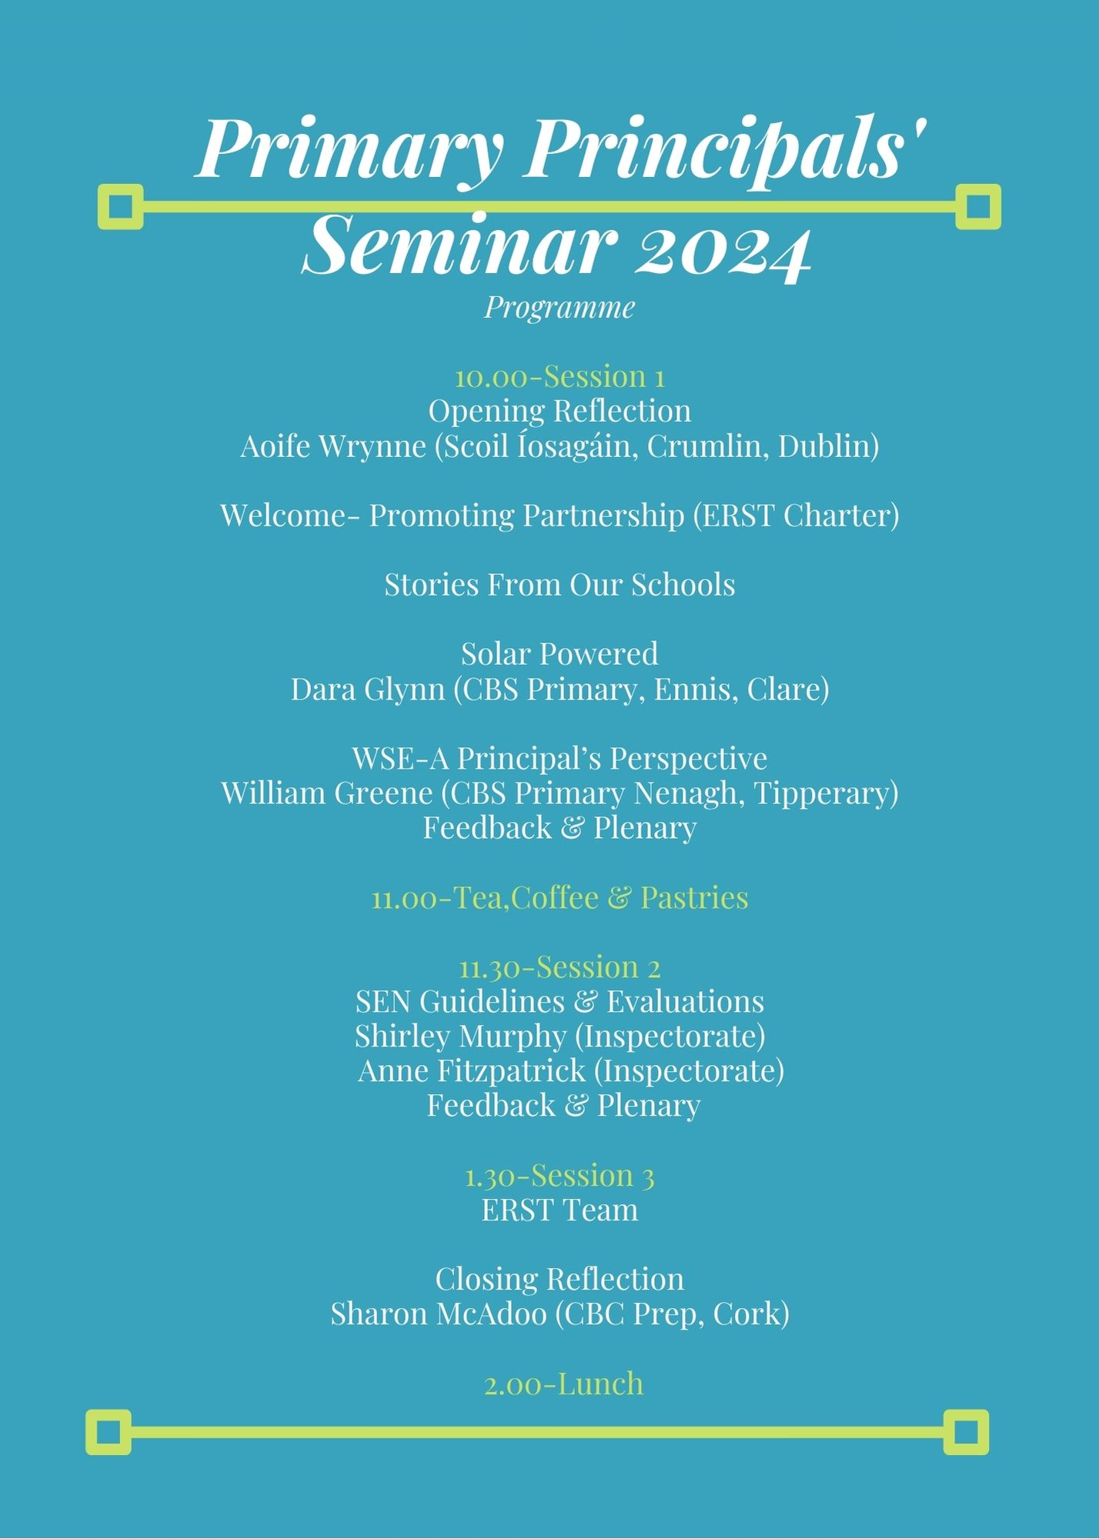

Slide 3
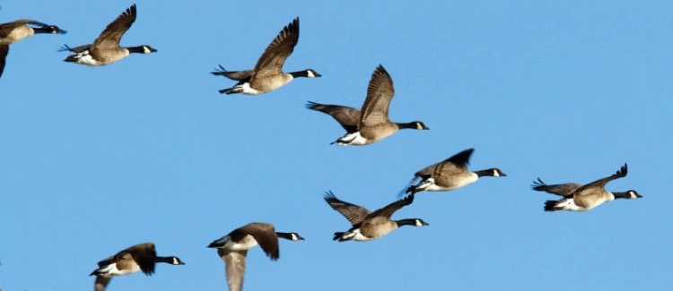

Slide 4
Promoting Partnership
Each bird flies slightly above the bird in front of them, reducing wind resistance.
The geese take turns being the leader, falling back when they get tired. This means they can fly for a long time before they need to rest.
The V formation makes it easier to keep track of every bird in the group. Flying in formation helps each member to communicate and coordinate with the group more effectively.

Slide 5
We thank God for the skills, talents and service that all present bring to our school communities.
Lord, on our journey of new beginnings, we ask that your guiding hand enables us to show courage and wisdom as we watch over our schools.

Slide 6
God of wisdom and understanding. Guide us in our work as leaders of Edmund Rice Schools. Strengthen us and nourish us as we seek to serve our schools.
Through Christ our Lord.
Amen

Slide 7
Reflection
Take a moment to pause and reflect.
What will feed and sustain you on your leadership journey?

